Slide 1
Home Owl
Autonomous Security Robot
Samantha Buckle
Dylan Dauz
Sameeh Olipani
Sheldon Peters

Slide 2
Problem
Homes, businesses, and facilities become vulnerable at night to break-ins or intrusions
On average, 3,062 burglaries happen in the U.S. every day
Full security systems are:
Semi-permanent
Costly
Can take time to install

Slide 3
Project Goals
This project aims to design and build a robot for use in the monitoring of indoor spaces
Robot will be capable of:
Autonomous navigation of a building or room without the need for human control
Utilize sensors to detect loud noises or the presence of a person
Flash lights and play an alarm sound when disturbance is detected
Get signal from remote control to turn the system on and off

Slide 4
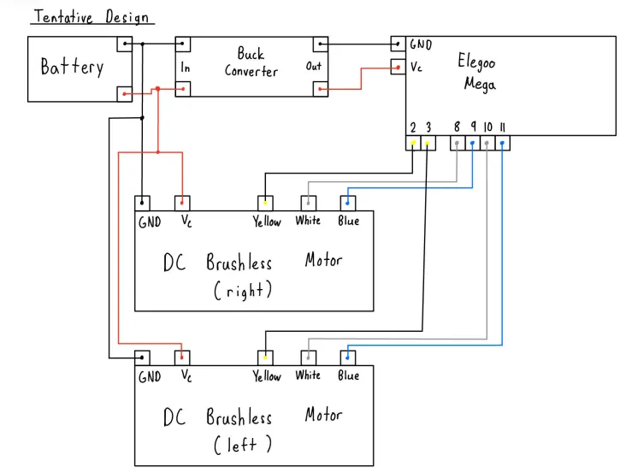
Wiring Diagram

Slide 5
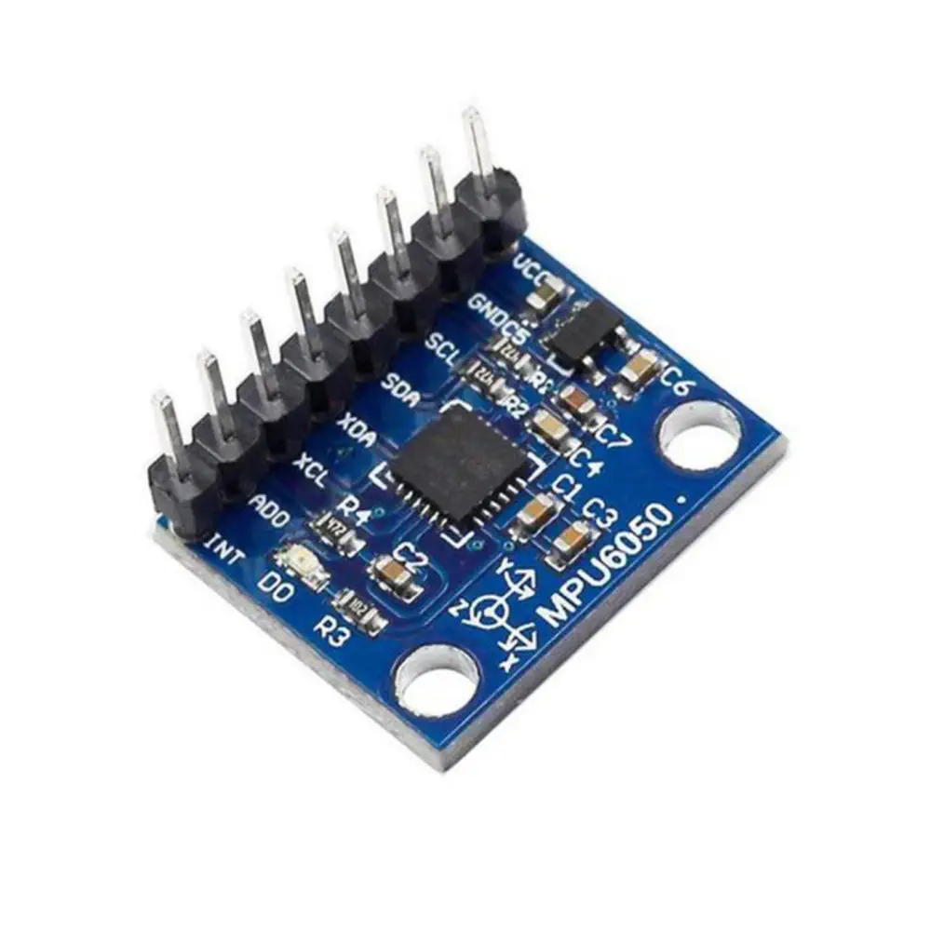
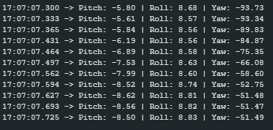
PID
GY-521
Registers the acceleration value of all axes
Can give us pitch, roll, and yaw
CHANGE TO BE UPDATED

Slide 6
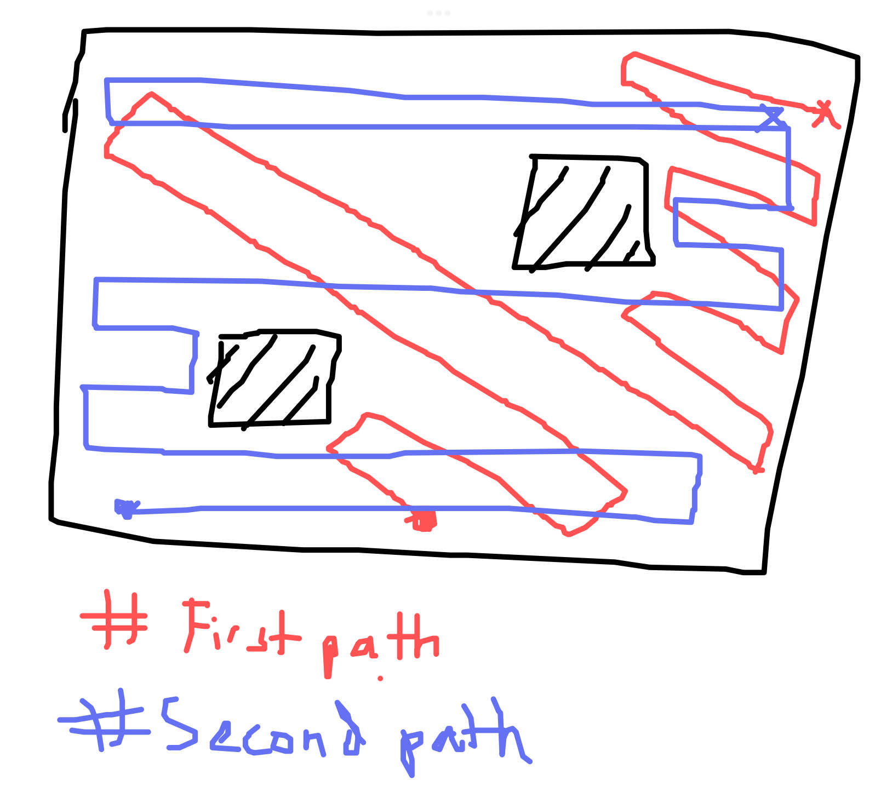
Movement Algorithm
------------------- START MOVING -----------------
Navigation Loop (10-15 sec)
Check for obstacle
Move through room using ToF sensor
Turning with PID: use gyro to get current angle & turn to desired angle
------------------- STOP MOVING -------------------
Sense Loop (5 sec)
Sense sound
Sense for motion using PIR
If motion then alarm, light, ect
----------------- RESUME MOVING ----------------
CHANGE TO BE UPDATED

Slide 7
Next Steps
Notes:
Sam

